Slide 1



Marketing Research: From Customer Insights to Actions

Slide 2
LEARNING OBJECTIVES (LO) AFTER READING CHAPTER 7, YOU SHOULD BE ABLE TO: (1 of 2)
1. Identify the reason for conducting marketing research.
2. Describe the five-step marketing research approach that leads to marketing actions.
3. Explain how marketing uses secondary and primary data.

Slide 3
LEARNING OBJECTIVES (LO) AFTER READING CHAPTER 7, YOU SHOULD BE ABLE TO: (2 of 2)
4. Discuss the uses of observations, questionnaires, panels, experiments, and newer data collection methods.
5. Explain how data analytics and data mining lead to marketing actions.
6. Describe three approaches to developing a company’s sales forecast.

Slide 4


MARKETING RESEARCH GOES TO THE MOVIES
A Film Industry Secret: Research
Movie Title Testing
Concept Testing & Script Assessment
Test Screening
Tracking Studies
Pirates of the Caribbean
Movie Trailer

Slide 5
THE ROLE OF MARKETING RESEARCH
What is Marketing Research?
The Challenges in Doing Good Marketing Research
Five-Step Marketing Research Approach
Decision
Decision Making

Slide 6
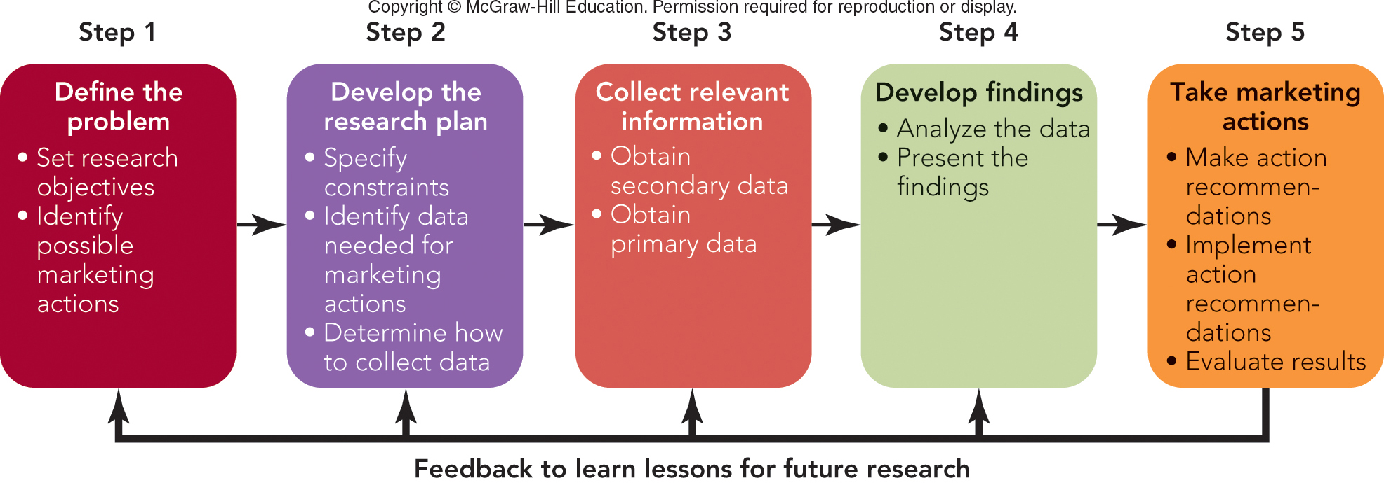
FIGURE 7-1 Five-step marketing research approach leading to marketing actions.
Jump to Appendix 1 long image description

Slide 7
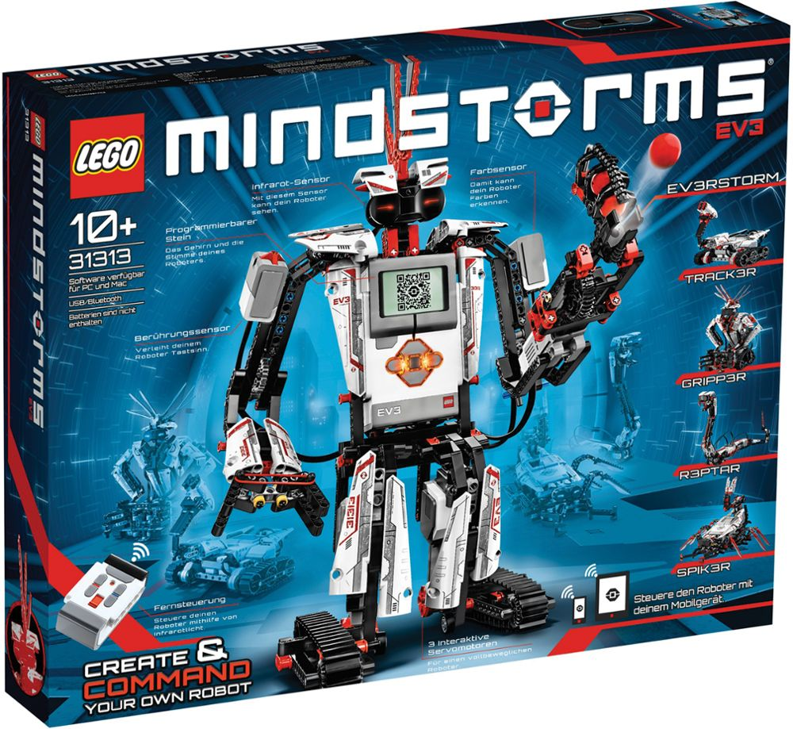
STEP 1: DEFINE THE PROBLEM SET THE RESEARCH OBJECTIVES (1 of 2)
Set the Research Objectives
Have a Clear Research Purpose
Identify Possible Marketing Actions
Lego EV3
Mindstorms
Video

Slide 8
STEP 1: DEFINE THE PROBLEM SET THE RESEARCH OBJECTIVES (2 of 2)
Measures of Success
Measure of Success: Playtime
Children Spend More Time Playing with New Design
Possible Marketing Actions
Introduce New Design
Drop Old Design

Slide 9
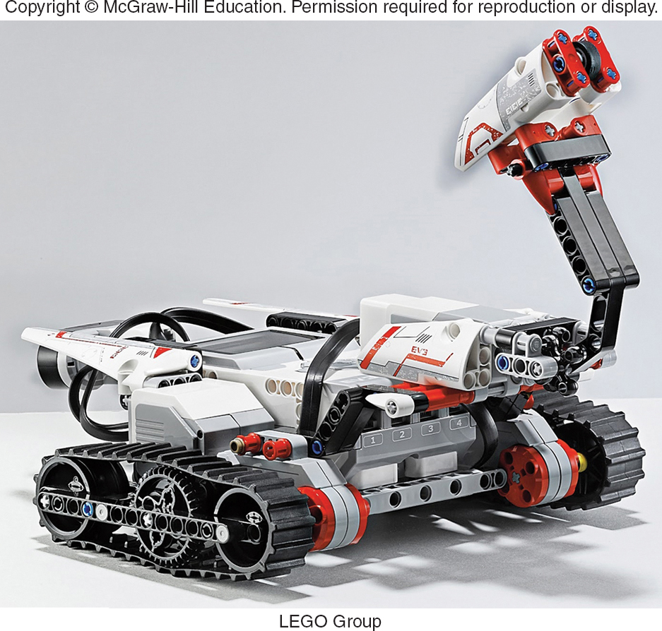
STEP 2: DEVELOP THE RESEARCH PLAN DETERMINE HOW TO COLLECT DATA
Constraints
Identify Data Needed for Marketing Actions
Identify Data Needed
Determine How to Collect Data
Concepts
Methods

Slide 10
STEP 3: COLLECT RELEVANT INFORMATION/DATA
Relevant Information for Rational, Informed Marketing Decision
Data
Secondary Data
Primary Data

Slide 11
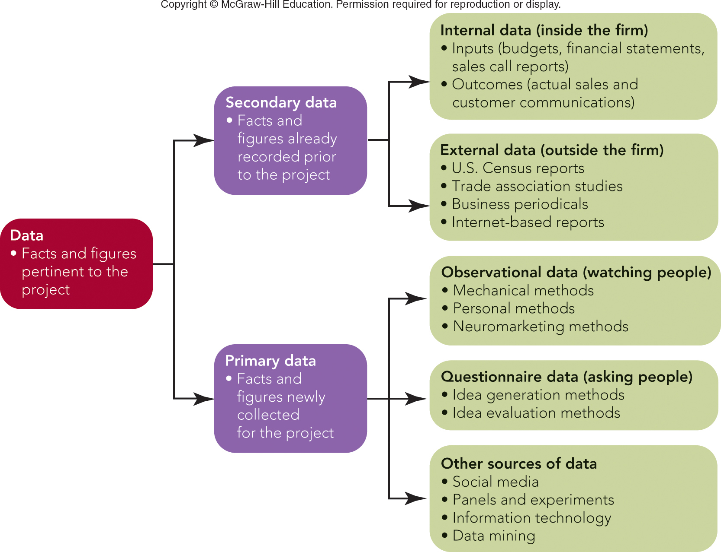
FIGURE 7-2 Types of marketing information
Jump to Appendix 2 long image description

Slide 12
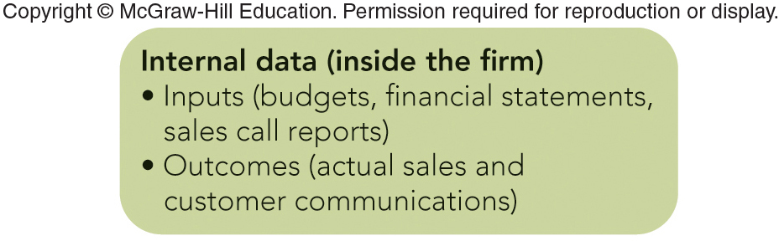
STEP 3: COLLECT RELEVANT DATA SECONDARY DATA (1 of 5)
Internal
Marketing Input Data
Marketing Outcome Data
Jump to Appendix 3 long image description

Slide 13
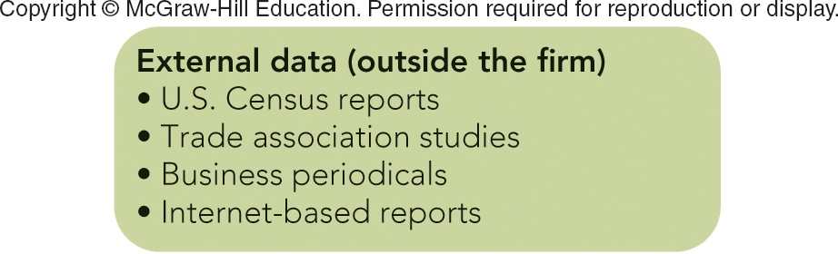
STEP 3: COLLECT RELEVANT DATA SECONDARY DATA (2 of 5)
External
Census Bureau
U. S. 2010 Census
American Community Survey
U. S. 2012 Economic Census
Census Video
Jump to Appendix 4 long image description

Slide 14
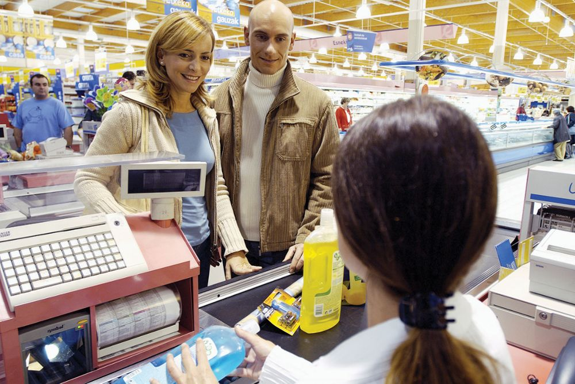
STEP 3: COLLECT RELEVANT DATA SECONDARY DATA (3 of 5)
External
Syndicated Panel
Nielsen TV Ratings
J.D. Power Surveys
IRI InfoScan

Slide 15
STEP 3: COLLECT RELEVANT DATA SECONDARY DATA (4 of 5)
External
Trade Associations
Universities
Business Periodicals

Slide 16

MARKETING MATTERS Online Databases and Internet Resources for Marketers
Sources of News & Articles:
LexisNexis --
CNBC --
Wall Street Journal --
Fox Business --
Sources of Statistical and Financial Data:
FedStats --
Census Bureau --
Portals and Search Engines:
USA.gov --
Google –

Slide 17
STEP 3: COLLECT RELEVANT DATA SECONDARY DATA (5 of 5)
Advantages
Time Savings
Inexpensive
Disadvantages
Out of Date
Definitions/Categories Not Right
Not Specific Enough

Slide 18
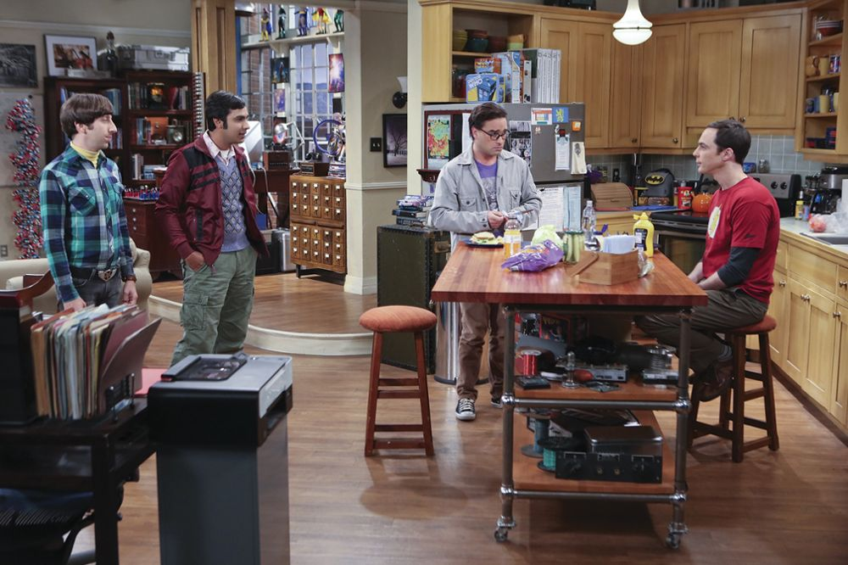
STEP 3: COLLECT RELEVANT DATA PRIMARY DATA—WATCHING PEOPLE (1 of 2)
Observational Data
Mechanical Methods
Nielsen’s People Meter
Nielsen’s TV Ratings

Slide 19
FIGURE 7-3 Nielsen Broadcast Ranking Report for network TV primetime households for the week of March 28, 2016.
Rank | Program | Network | Rating | Views (000)
1 | The Big Bang Theory | CBS | 8.8 | 14,238
2 | Dancing with the Stars | ABC | 7.8 | 11,952
3 | Empire | FOX | 7.4 | 12,455
4 | The Voice - Tue | NBC | 6.9 | 11,099
5 | The Voice | NBC | 6.9 | 11,355
6 | Little Big Shots | NBC | 6.7 | 11,329
7 | ACM Awards | CBS | 6.7 | 11,203
8 | NCIS | CBS | 6.6 | 10,381
9 | Blue Bloods | CBS | 6.5 | 10,396
10 | 60 Minutes | CBS | 6.1 | 9,526
Nielsen
Ratings
Source: Nielsen. Primetime Broadcast Programs. Report for the week of March 28, 2016. Viewing estimates include live viewing and DVR playback on the same day, defined as 3 A.M. to 3 A.M. Ratings are the percentage of TV homes in the U.S. tuned into television.

Slide 20


STEP 3: COLLECT RELEVANT DATA PRIMARY DATA—WATCHING PEOPLE (2 of 2)
Personal Methods
Mystery Shopper
Observation
Ethnographic Research
Neuromarketing Methods

Slide 21
STEP 3: COLLECT RELEVANT DATA PRIMARY DATA—ASKING PEOPLE (1 of 3)
Questionnaire Data
Idea Generation Methods – Coming Up with Ideas
Individual Interviews
Depth Interviews

Slide 22
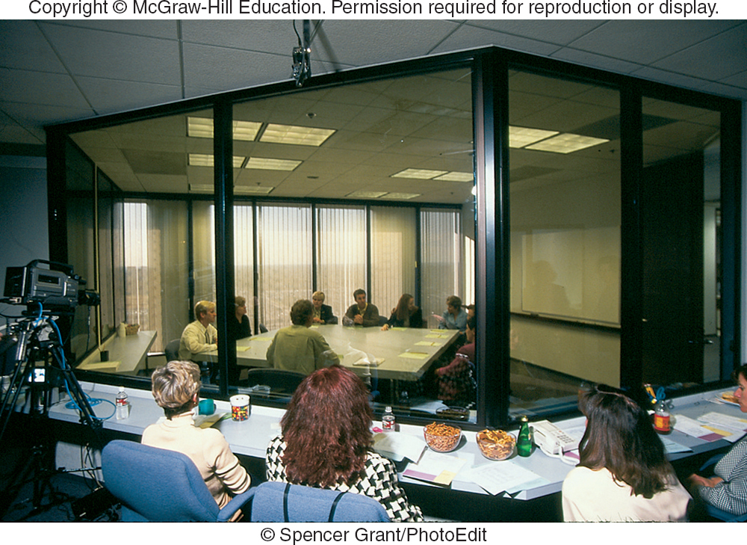
STEP 3: COLLECT RELEVANT DATA PRIMARY DATA—ASKING PEOPLE (2 of 3)
Idea Generation Methods–Coming Up with Ideas
Focus Groups
“The Next Big Thing”
Trend Hunter

Slide 23
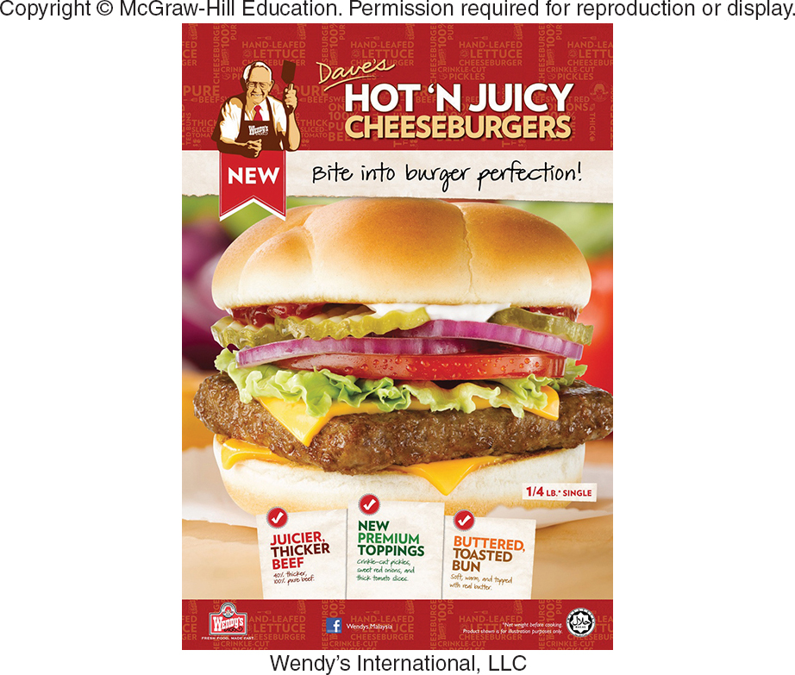
STEP 3: COLLECT RELEVANT DATA PRIMARY DATA—ASKING PEOPLE (3 of 3)
Idea Evaluation Methods – Testing an Idea
Personal Interview Surveys
Telephone Surveys
Mail/Fax Surveys
Online (E-Mail/Internet) Surveys
Mall Intercept Interview Surveys

Slide 24
FIGURE 7-A Comparison of Types of Surveys
BASIS OF COMPARISON | MAIL, ONLINE, & FAX SURVEYS | TELEPHONE SURVEYS | INDIVIDUAL INTERVIEW AND MALL INTERCEPT SURVEYS
Cost per completed survey | Usually the least expensive, assuming adequate response rates | Moderately expensive, assuming reasonable completion rates | Most expensive because of interviewer’s time and travel expenses
Ability to probe and ask complex questions | Little, since self-administered format must be short and simple | Some, since interviewer can probe and elaborate on questions | Much, since interviewer can show visuals, probe, and establish rapport
Opportunity for interviewer to bias results | None, since survey form is completed without the interviewer | Some, because of voice inflection of interviewer | Significant, because of voice and facial expressions of interviewer
Anonymity given to respondents | Complete, since no signature is needed | Some, because of telephone contact | Little, because of face-to-face contact

Slide 25
STEP 3: COLLECT RELEVANT DATA PRIMARY DATA—QUESTION FORMATS
Open-Ended Questions
Closed-End or Fixed Alternative Questions
Dichotomous Questions
Semantic Differential Questions
Likert Scale Questions

Slide 26
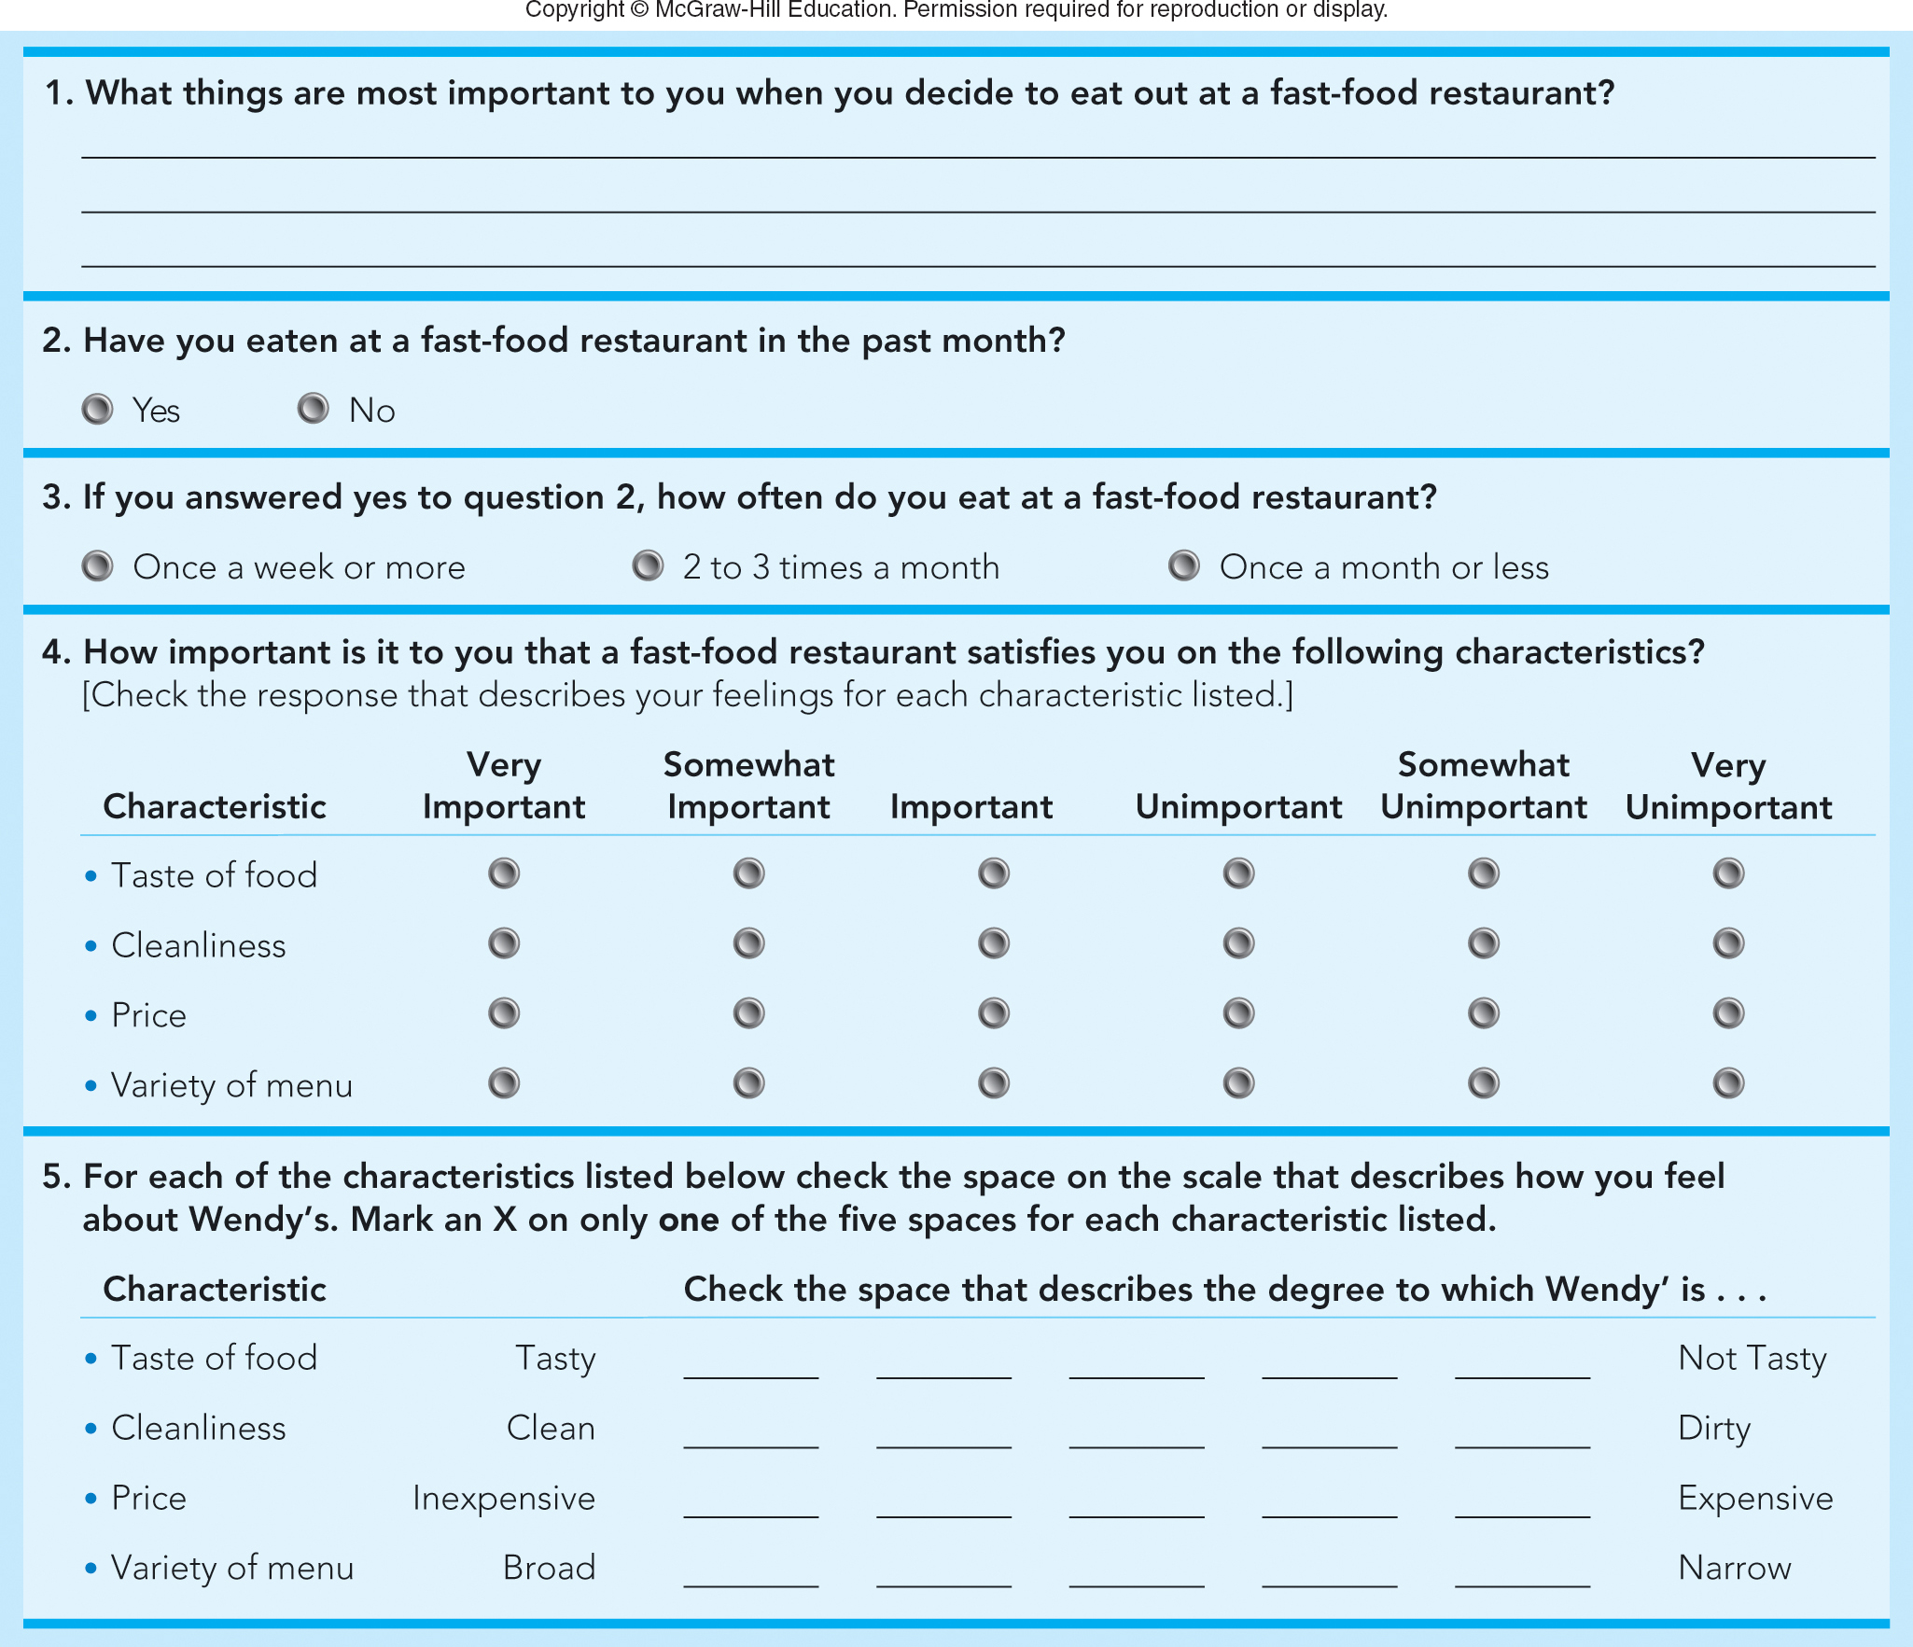
FIGURE 7-4 Different types of questions in a sample Wendy’s survey (Q1 – Q5)
Jump to Appendix 5 long image description

Slide 27
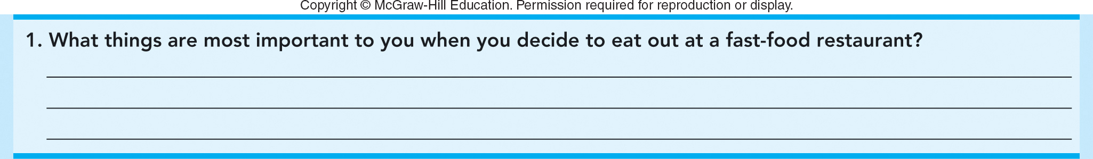
FIGURE 7-4A (Q1) Sample Wendy’s survey: Open-ended question

Slide 28

FIGURE 7-4A (Q2) Sample Wendy’s survey: Dichotomous question

Slide 29

FIGURE 7-4A (Q3) Sample Wendy’s survey: Multiple choice question
Jump to Appendix 6 long image description

Slide 30
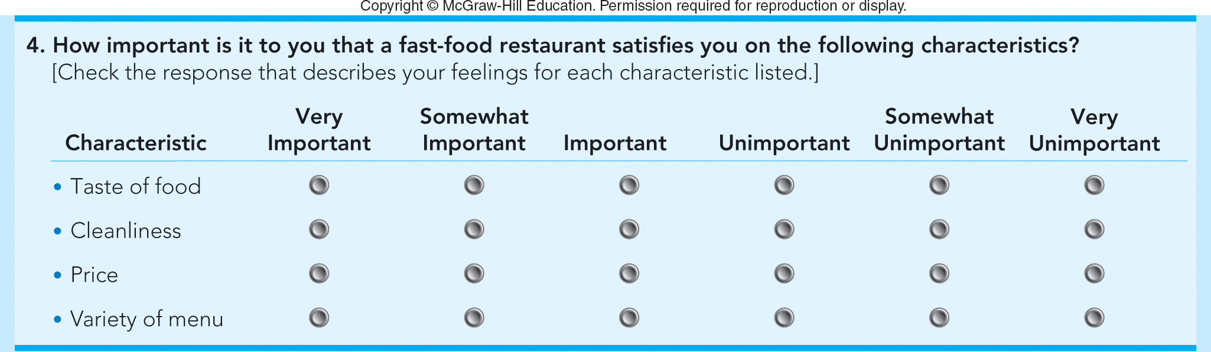
FIGURE 7-4A (Q4) Sample Wendy’s survey: Attitudinal question
Jump to Appendix 7 long image description

Slide 31
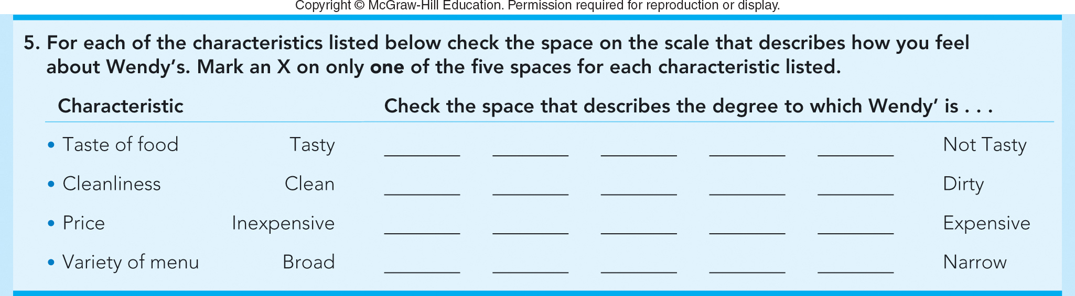
FIGURE 7-4A (Q5) Sample Wendy’s survey: Semantic differential scale question
Jump to Appendix 8 long image description

Slide 32
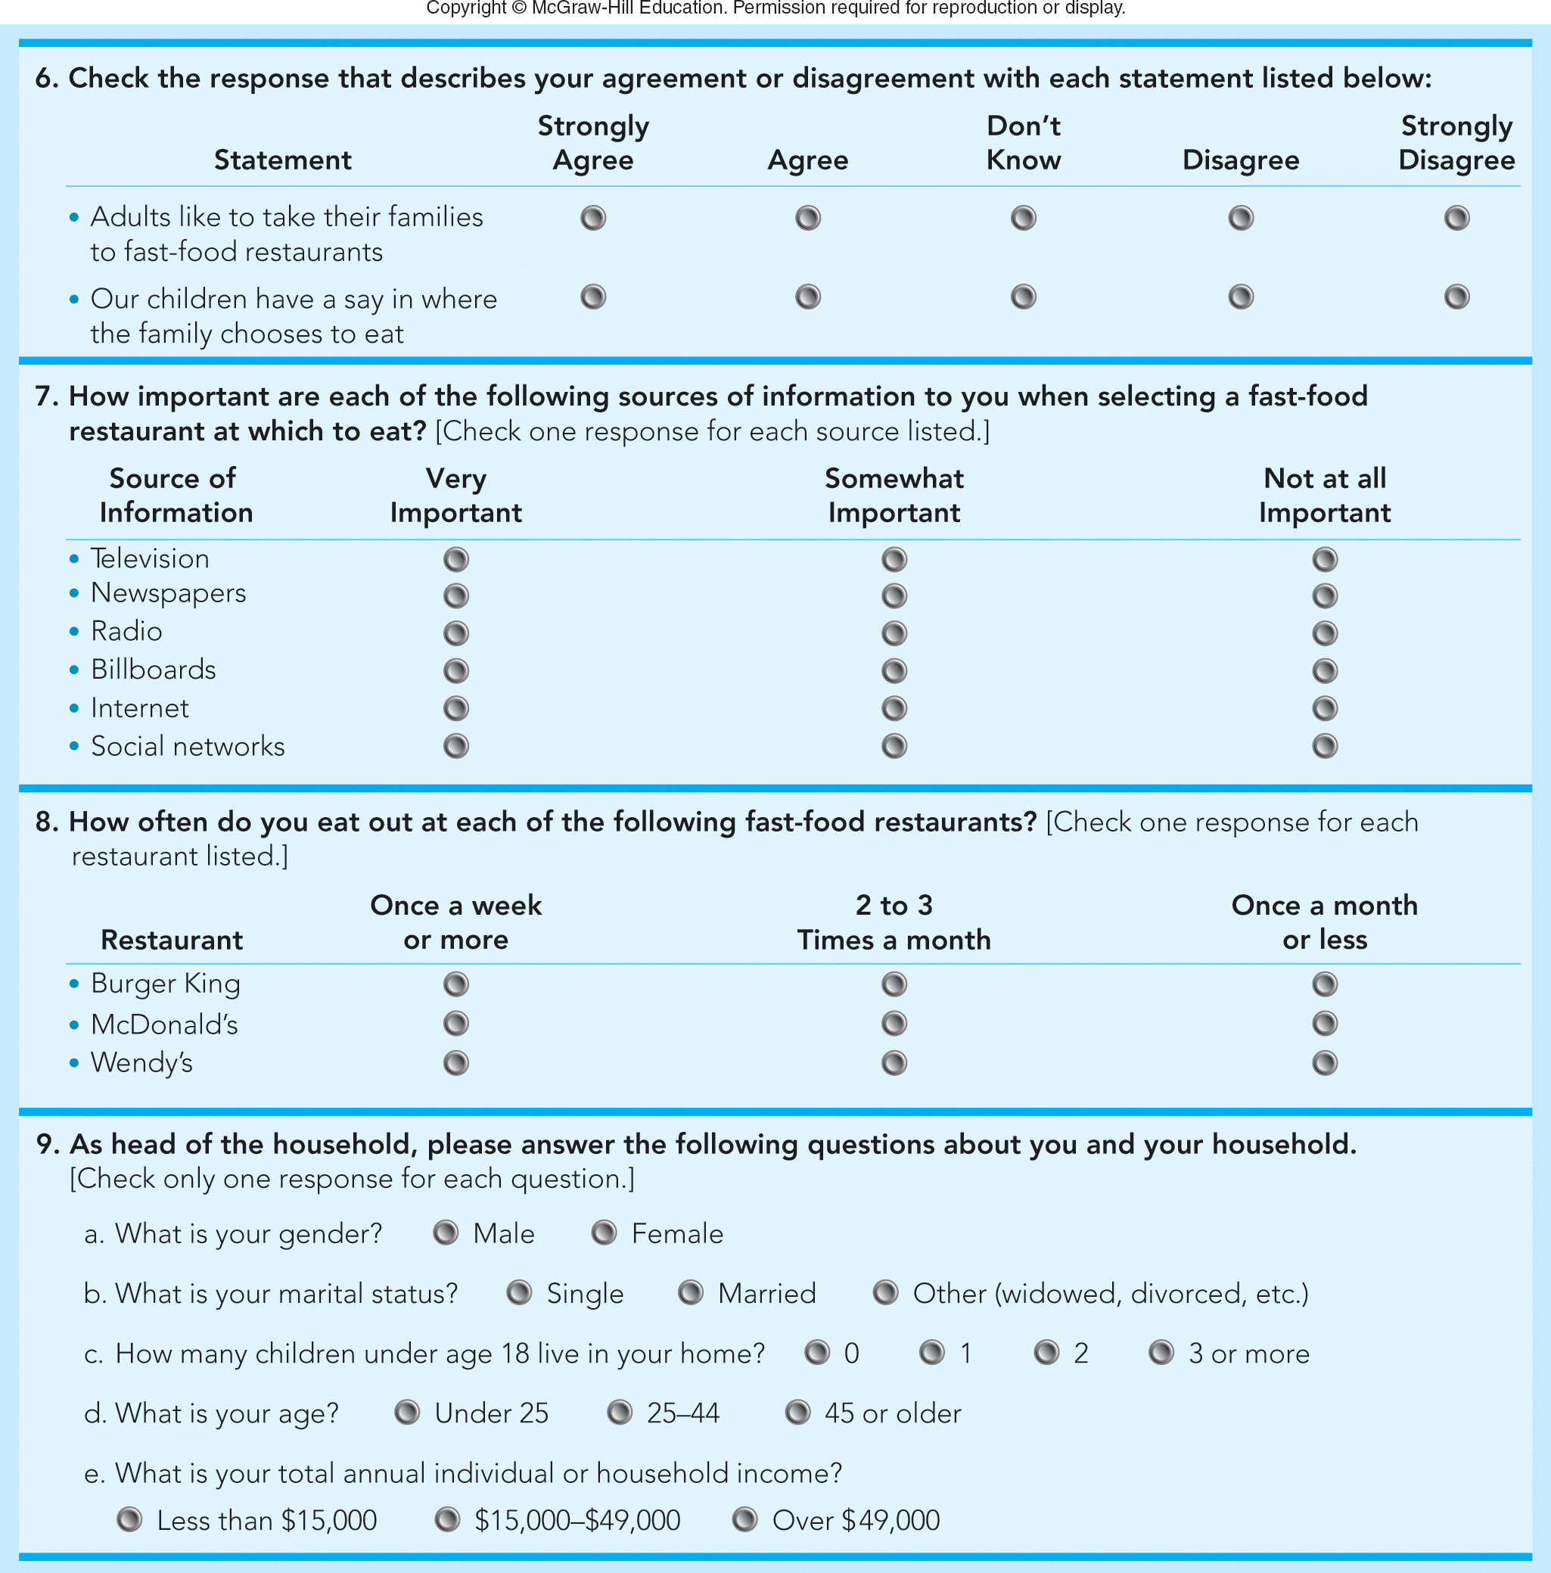
FIGURE 7-4B Different types of questions in a sample Wendy’s survey (Q6 – Q9)
Jump to Appendix 10 long image description

Slide 33
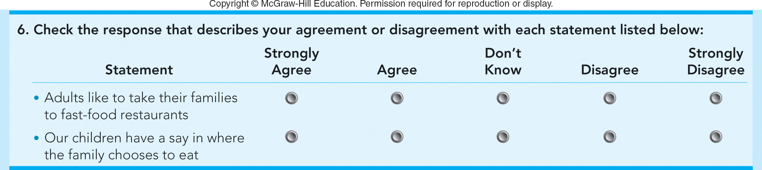
FIGURE 7-4B (Q6) Sample Wendy’s survey: Likert scale question
Jump to Appendix 10 long image description

Slide 34
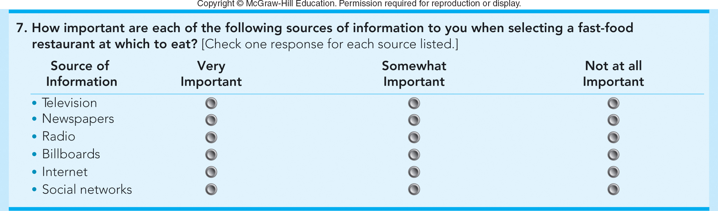
FIGURE 7-4B (Q7) Sample Wendy’s survey: Media behavior question
Jump to Appendix 11 long image description

Slide 35
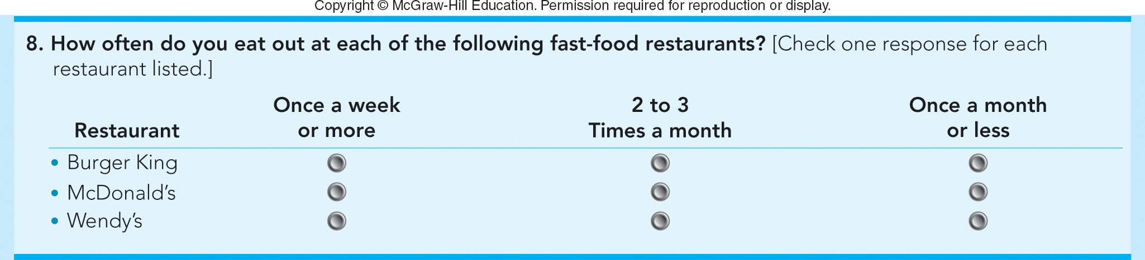
FIGURE 7-4B (Q8) Sample Wendy’s survey: Usage behavior question
Jump to Appendix 12 long image description

Slide 36
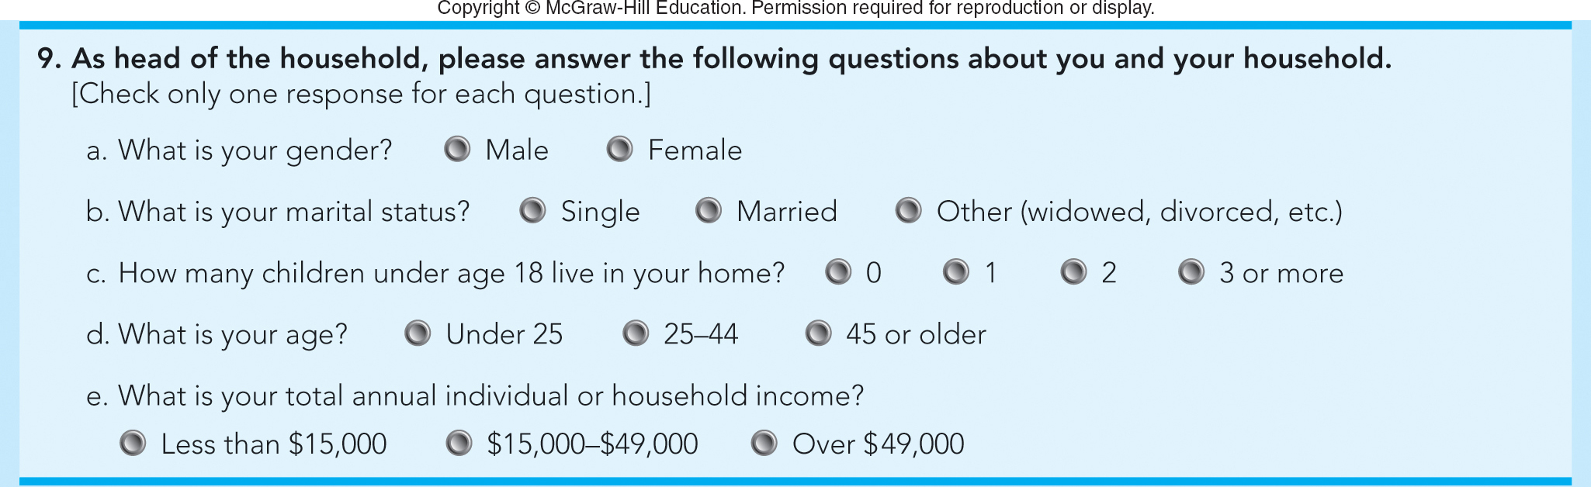
FIGURE 7-4B (Q9) Sample Wendy’s survey: Demographic questions
Jump to Appendix 13 long image description

Slide 37
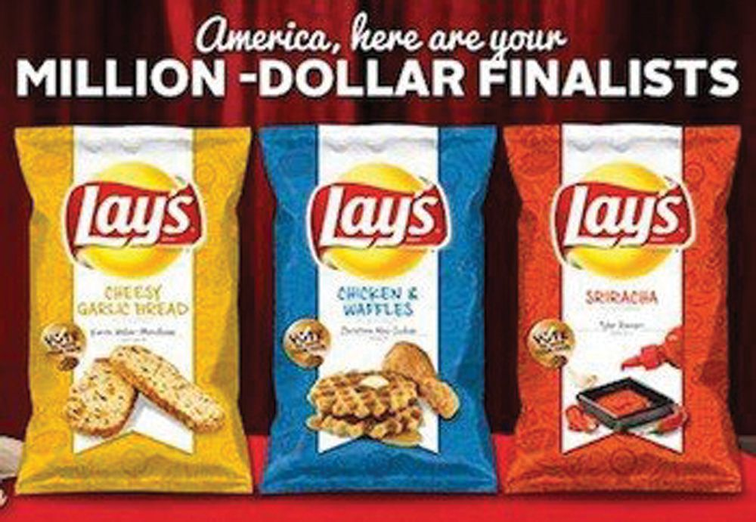
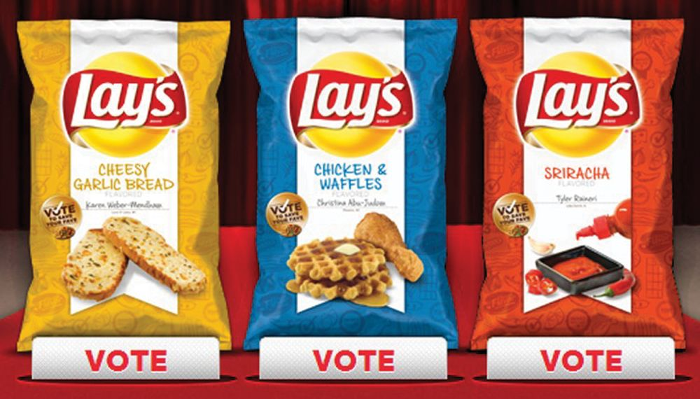
STEP 3: COLLECT RELEVANT DATA PRIMARY DATA—OTHER SOURCES (1 of 2)
Social Media Can Provide Ideas for New Products and Services
Use Social Media Listening Tools

Slide 38
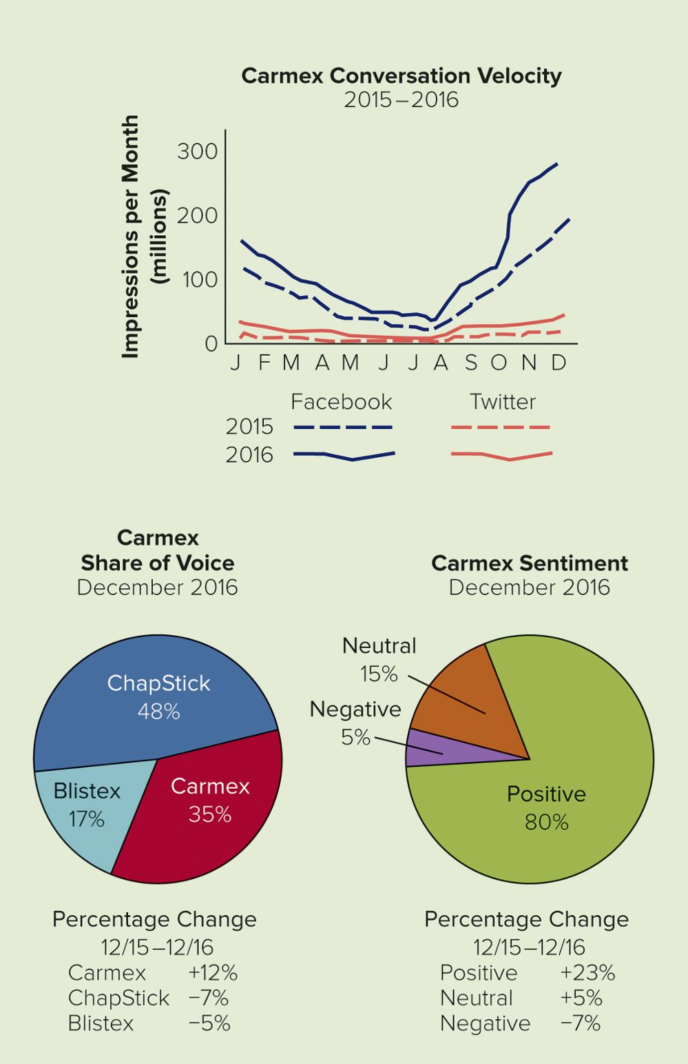
APPLYING MARKETING METRICS Are the Carmex Social Media Programs Working Well?
Conversation
Velocity
Share of Voice
Sentiment
Carmex Lip Balm
Facebook Page
Jump to Appendix 14 long image description

Slide 39
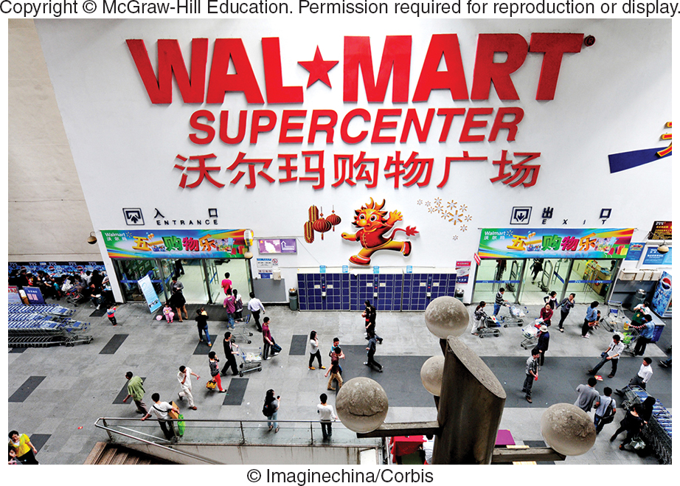
STEP 3: COLLECT RELEVANT DATA PRIMARY DATA—OTHER SOURCES (2 of 2)
Panels
Experiments
Independent Variable: The Cause (Drivers)
Dependent Variable: The Result
Test Markets

Slide 40
STEP 3: COLLECT RELEVANT DATA ADVANTAGES/DISADVANTAGES OF PRIMARY DATA
Advantages
More Flexible
More Specific to the Problem
Disadvantages
Expensive
Time Consuming to Collect

Slide 41
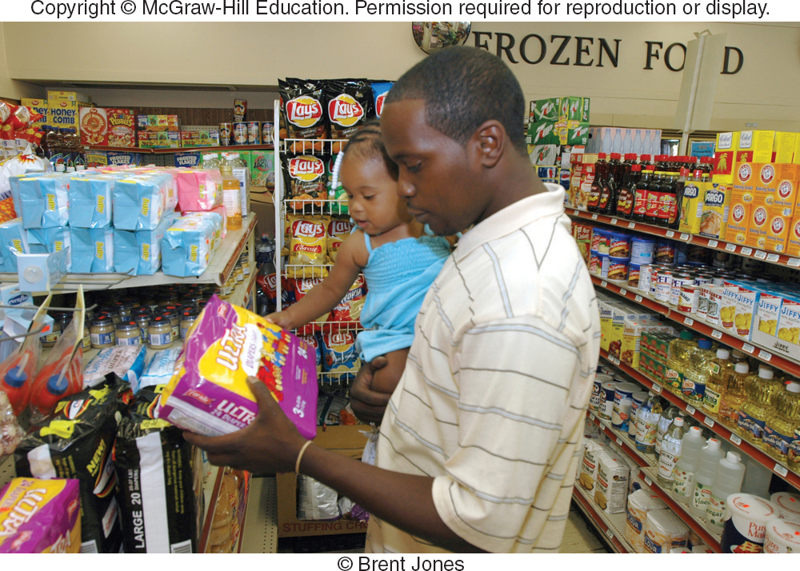
STEP 4: DEVELOP FINDINGS ANALYZE THE DATA
Big Data and Data Analytics
Information Technology
Transform Data into Useful Information
Data Visualization
Intelligent Enterprise
Data Mining
RFID Technology

Slide 42
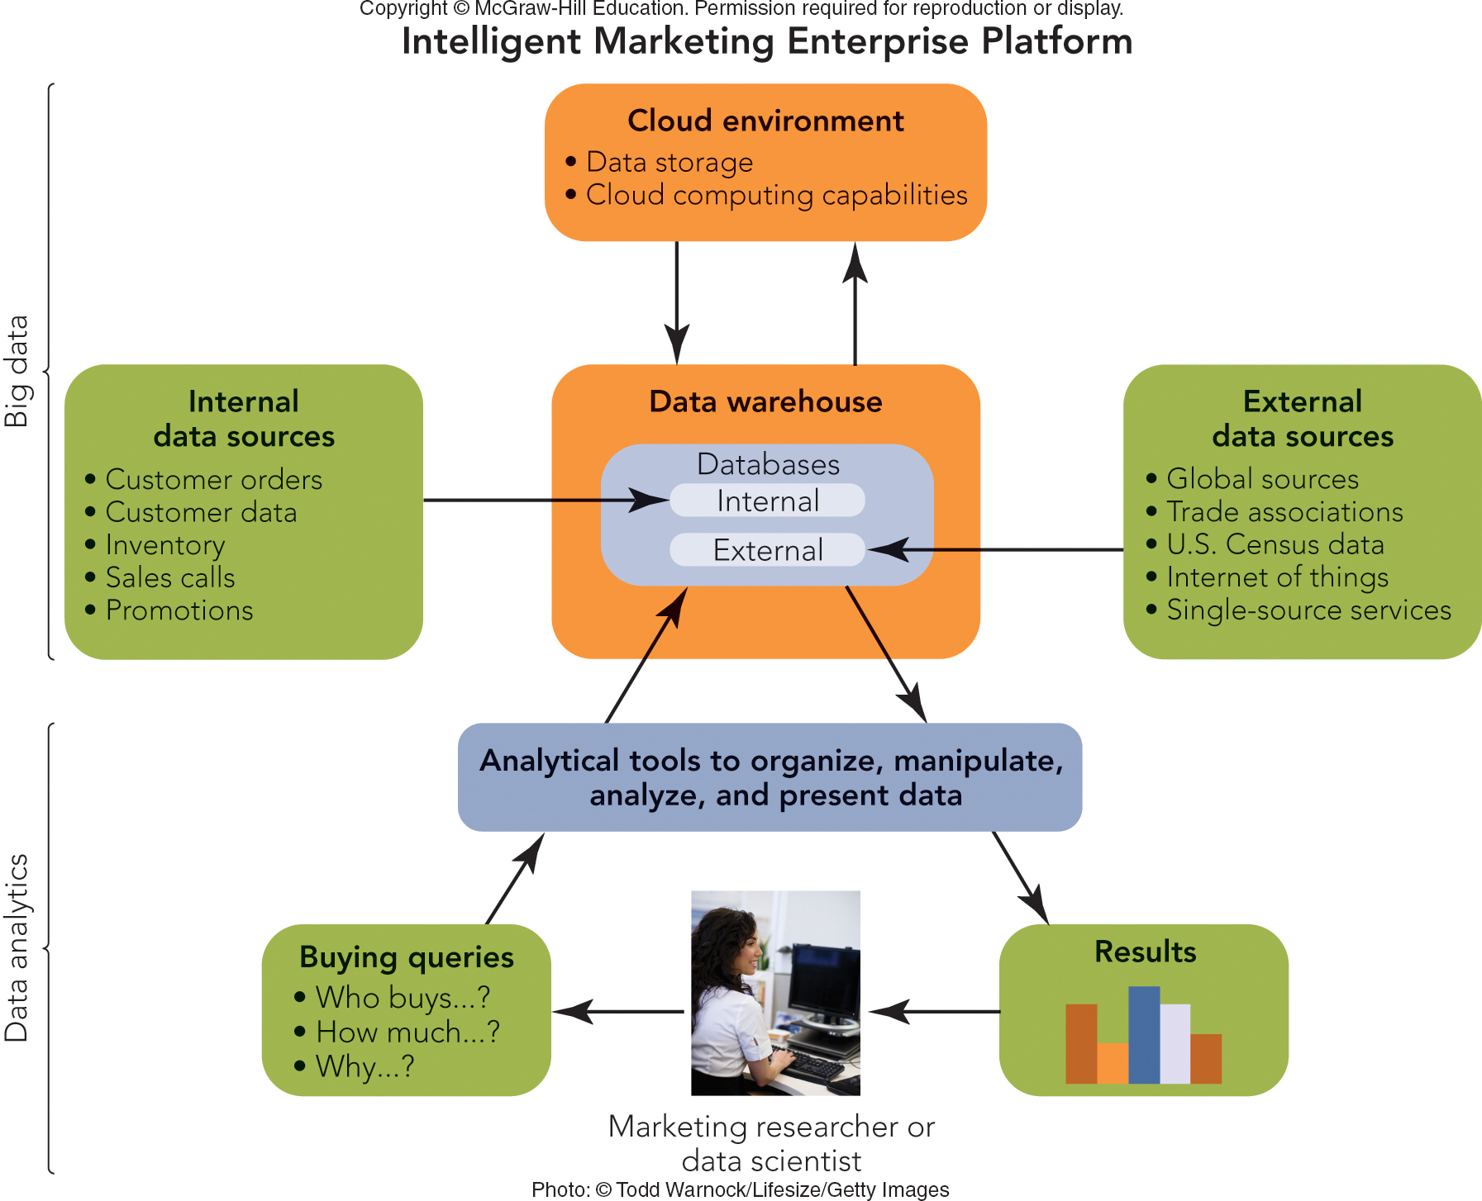
FIGURE 7-5 How marketing researchers and managers use information technology to turn information into action.
Jump to Appendix 15 long image description

Slide 43
MAKING RESPONSIBLE DECISIONS NO MORE PERSONAL SECRETS: THE DOWNSIDE OF DATA MINING
Reveals Personal Information
Collected via Tracking Devices
(Examples: Cookies and Apps)
Enables Personalization and Targeting
Ghostery
Video

Slide 44
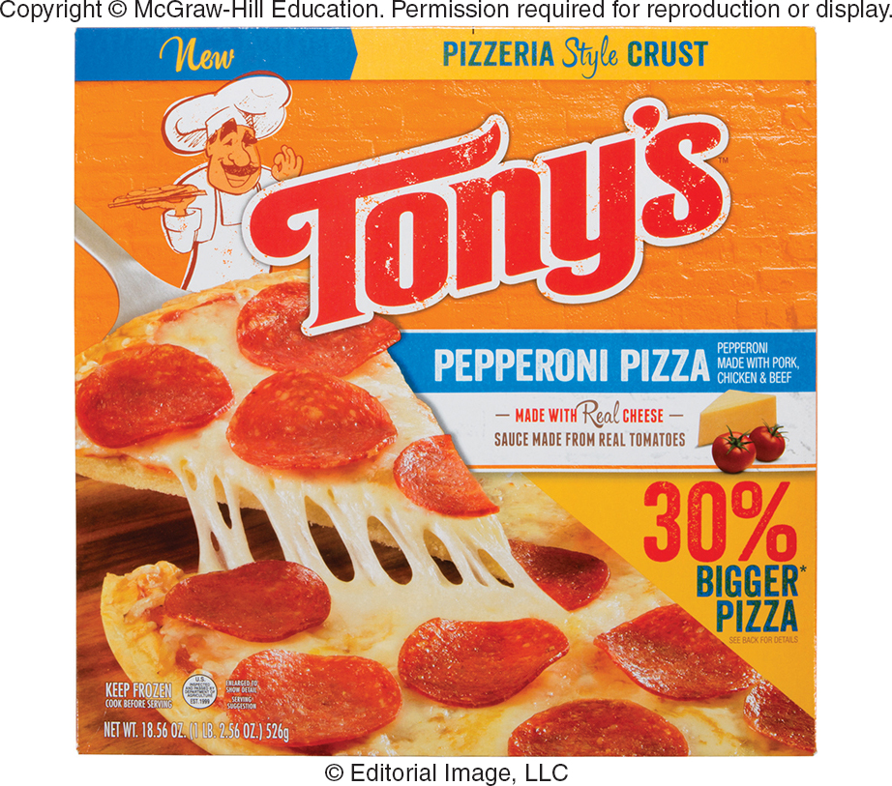
STEP 4: DEVELOP FINDINGS
Analyze the Data
How are Sales?
What Factors Contribute to Sales Trends?
Present the Findings

Slide 45
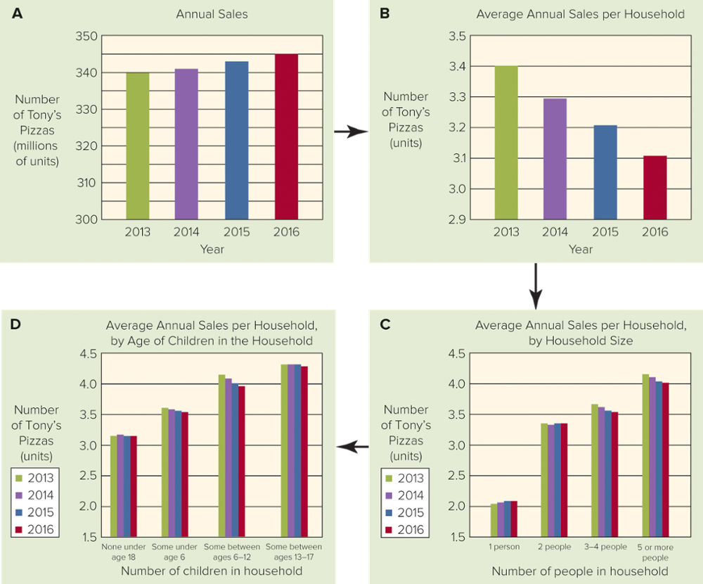
FIGURE 7-6 Marketing dashboards that present findings to Tony’s marketing manager that lead to recommendations and actions.
Jump to Appendix 16 long image description

Slide 46
STEP 5: TAKE MARKETING ACTIONS
Make Action Recommendations
Implement the Action Recommendations
Evaluate the Results
The Decision Itself
The Decision Process Used

Slide 47
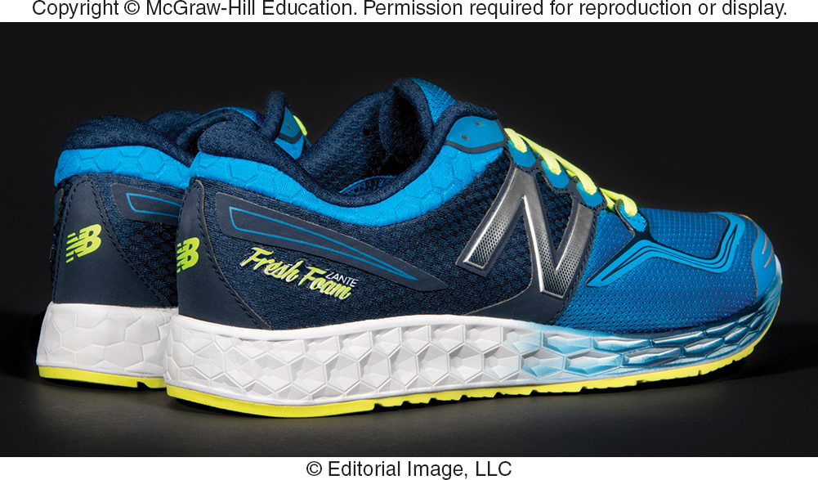
SALES FORECASTING TECHNIQUES (1 of 2)
Sales Forecast
Judgments of the Decision Maker
Direct Forecast
Lost-Horse Forecast
Surveys of Knowledgeable Groups
Survey of Buyers’ Intentions Forecast
Salesforce Survey Forecast

Slide 48
SALES FORECASTING TECHNIQUES (2 of 2)
Statistical Methods
Trend Extrapolation: Extending a Pattern Observed in Past Data into the Future
Linear Trend Extrapolation: When the Pattern is Described with a Straight Line

Slide 49
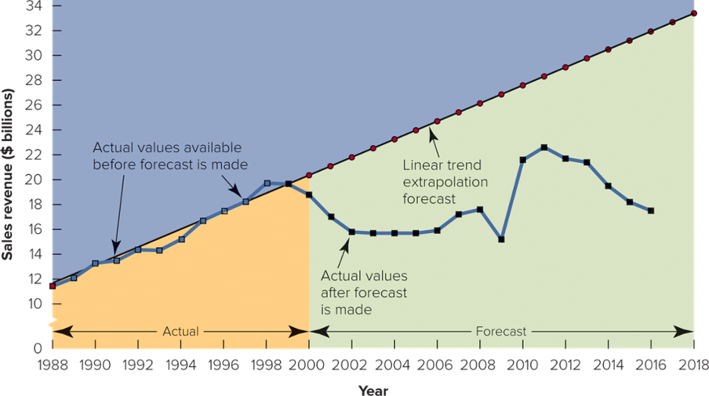
FIGURE 7-7 Linear trend extrapolation of sales revenues at Xerox, made at the start of 2000. Copyright © McGraw-Hill Education. Permission required for reproduction or display.
Jump to Appendix 17 long image description

Slide 50
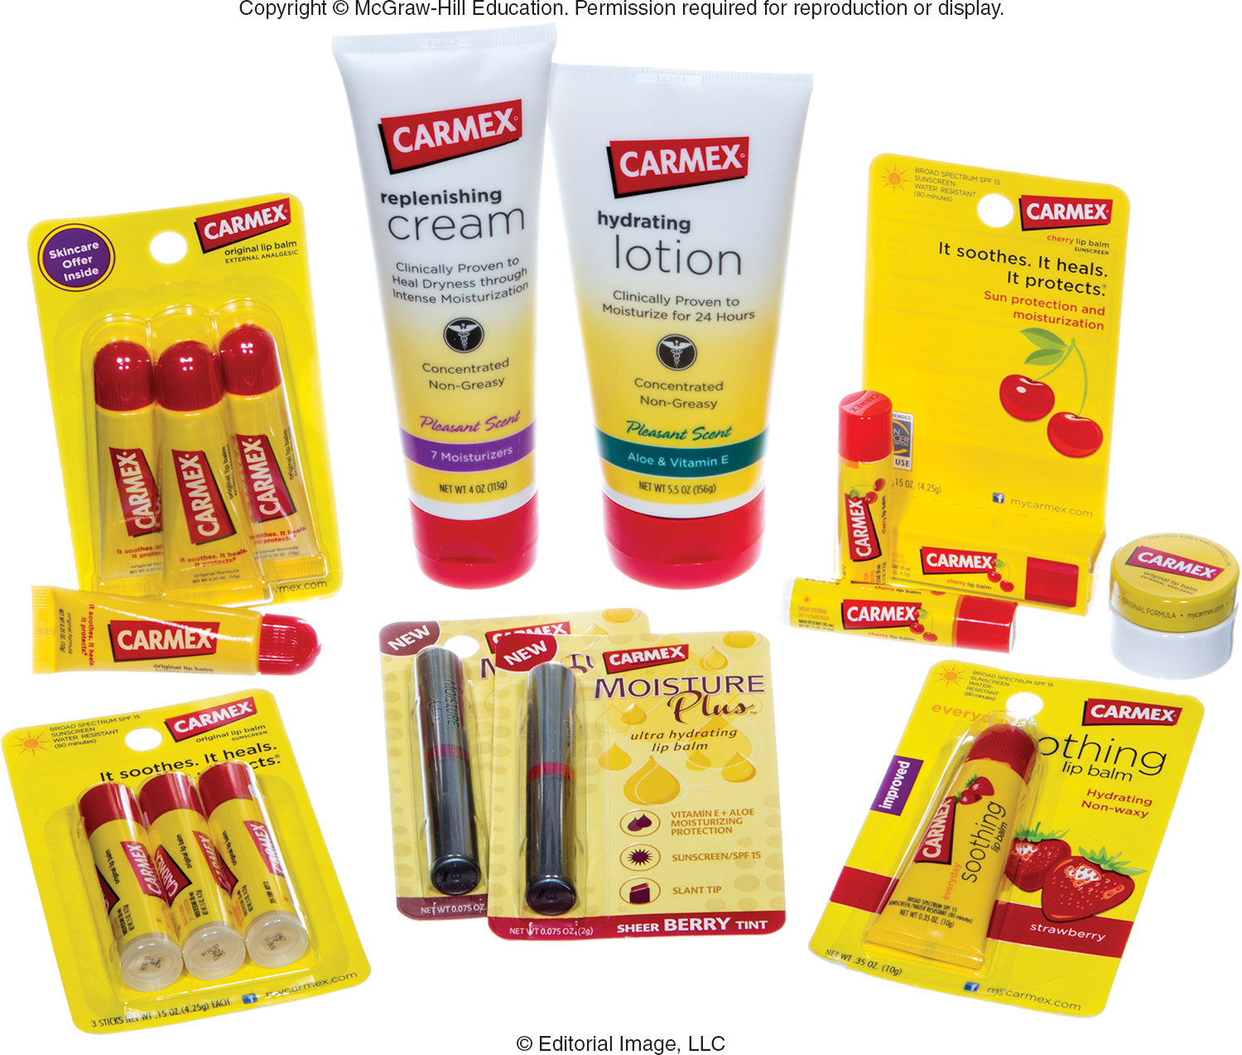
VIDEO CASE 7 CARMEX [A]: LEVERAGING FACEBOOK FOR MARKETING RESEARCH
Carmex
Video Case

Slide 51
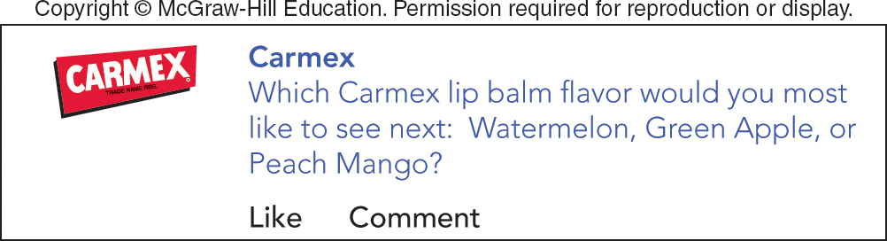
VIDEO CASE 7 Carmex [A] (1 of 7)
Jump to Appendix 18 long image description

Slide 52
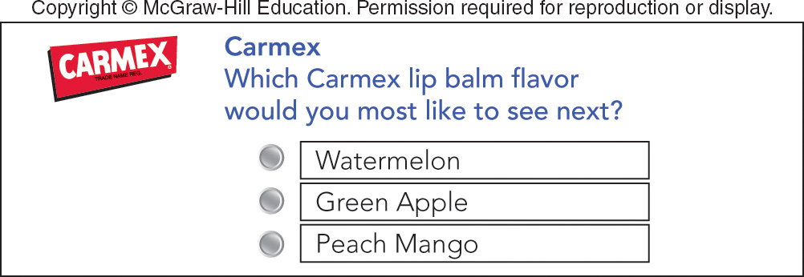
VIDEO CASE 7 Carmex [A] (2 of 7)
Jump to Appendix 19 long image description

Slide 53
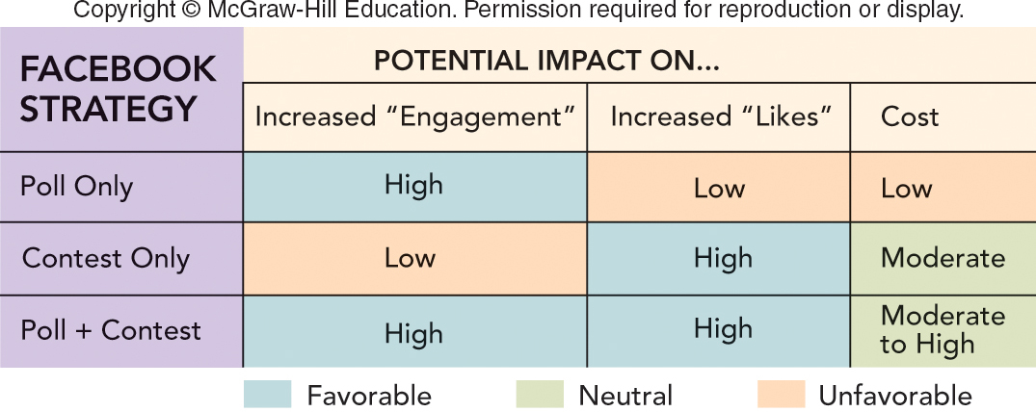
FIGURE 3 Potential results from three possible Facebook strategies.
Jump to Appendix 20 long image description

Slide 54
VIDEO CASE 7 Carmex [A] (3 of 7)
What are the advantages and disadvantages for the Carmex marketing team in collecting data to narrow the flavor choices from three to two using (a) an online survey of a cross-section of Internet households or (b) an online survey of Carmex Facebook likers?

Slide 55
VIDEO CASE 7 Carmex [A] (4 of 7)
(a) On a Facebook brand page, what are “engagement” and “likes” really measuring? (b) For Carmex, which is more important and why?

Slide 56
VIDEO CASE 7 Carmex [A] (5 of 7)
(a) What evokes consumers “engagement” on a brand page on Facebook? (b) What attracts consumers to “like” a brand page on Facebook?

Slide 57
VIDEO CASE 7 Carmex [A] (6 of 7)
(a) What are the advantages of using a fixed-alternative poll question on Facebook? (b) When do you think it would be better to use an open-ended question?

Slide 58
VIDEO CASE 7 Carmex [A] (7 of 7)
(a) If you had a limited budget and two weeks to decide which two flavors to put into quantitative testing, would you choose a “poll only” or a “contest only” strategy? Why? (b) If you had a sizeable budget and two months to make the same decision, which scenario would you choose? Why?

Slide 59
IN-CLASS ACTIVITY 7-1
INTERPRETING CENSUS DATA

Slide 60
ICA 7-1 Interpreting Census Data
Learn How Census Data is Collected
Locate Specific Data
Identify Size of Market Segments
US Census
Web Site
Census Promotional Video
ACS Promotional Video

Slide 61
IN-CLASS ACTIVITY 7-2
WEBSITES FOR MARKETERS

Slide 62
ICA 7-2 Websites for Marketers
American Marketing Association
American Advertising Federation
The Wall Street Journal
Drudge Report
Bloomberg Businessweek
Fox Business
CNBC
YouTube
Google
eBay
Amazon.com
USA.gov

Slide 63
IN-CLASS ACTIVITY 7-3
DESIGNING A TASTE TEST SURVEY FOR HOWLIN’ COYOTE CHILI

Slide 64
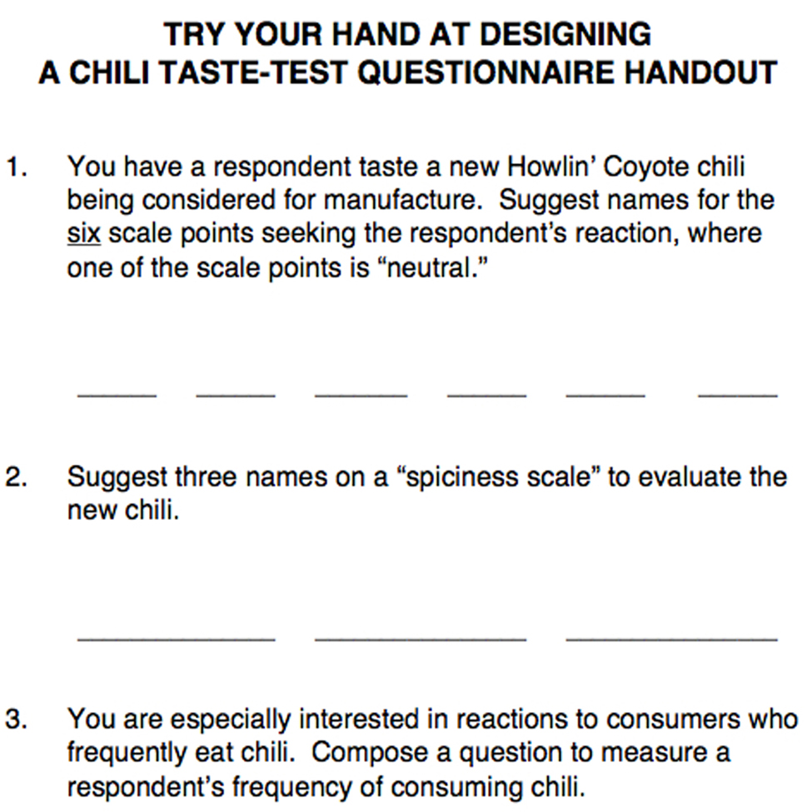
Howlin design survey.

Slide 65
IN-CLASS ACTIVITY 7-4
PEPSI VS. COKE TASTE TEST

Slide 66
ICA 7-4 Pepsi vs. Coke Taste Test Challenge
Pepsi vs. Coke Taste Test Challenge
Pepsi Taste Test Ad
Coke Taste Test Ad

Slide 67


Marketing Research
Marketing research is the process of defining a marketing problem and opportunity, systematically collecting and analyzing information, and recommending actions.

Slide 68
Measures of Success
Measures of success are criteria or standards used in evaluating proposed solutions to the problem.

Slide 69
Constraints
Constraints are, in a decision, the restrictions placed on potential solutions to a problem.

Slide 70
Data
Data are the facts and figures related to the project that are divided into two main parts: secondary data and primary data.

Slide 71
Secondary Data
Secondary data are the facts and figures that have already been recorded prior to the project at hand.

Slide 72
Primary Data
Primary data are the facts and figures that are newly collected for the project.

Slide 73
Observational Data
Observational data are the facts and figures obtained by watching, either mechanically or in person, how people actually behave.

Slide 74
Questionnaire Data
Questionnaire data are the facts and figures obtained by asking people about their attitudes, awareness, intentions, and behaviors.

Slide 75
Information Technology
Information technology involves operating computer networks that can store and process data.

Slide 76
Sales Forecast
A sales forecast consists of the total sales of a product that a firm expects to sell during a specified time period under specified environmental conditions and its own marketing efforts.

Slide 77
Appendix 1 FIGURE 7-1 Five-step marketing research approach leading to marketing actions
Step 1 define the problem. Set research objectives. Identify possible marketing actions.
Step 2 develop the research plan. Specify constraints. Identify data needed for marketing actions. Determine how to collect data.
Step 3 collect relevant information. Obtain secondary data. Obtain primary data.
Step 4 develop findings. Analyze the data present. Present the findings.
Step 5 take marketing actions. Make action recommendations. Implement action recommendations. Evaluate results.
Each step also utilizes feedback to learn lessons for future research.
Return to slide

Slide 78
Appendix 2 FIGURE 7-2 Types of marketing information
Data (facts and figures pertinent to the project) divides into two data branches. The first data branch is primary data (facts and figures newly collected for the project). This further breaks down into three types of data:
1. Observational data (watching people). Mechanical methods. Personal methods. Neuromarketing methods.
2. Questionnaire data (asking people). Idea generation methods. Idea evaluation methods.
3. Other sources of data. Social media. Panels and experiments. Information technology. Data mining.
The second data branch is secondary data (facts and figures already recorded prior to the project). This further breaks down into two types of data:
1. Internal data (inside the firm). Inputs (budgets, financial statements, sales call reports). Outcomes (actual sales and customer communications).
2. External data (outside the firm). U.S. Census reports. Trade association studies. Business periodicals. Internet-based reports.
Return to slide

Slide 79
Appendix 3 STEP 3: COLLECT RELEVANT DATA SECONDARY DATA (1 of 5)
The two aspects of internal data (inside the firm) are inputs (budgets, financial statements, sales call reports) and outcomes (actual sales and customer communications).
Return to slide

Slide 80
Appendix 4 STEP 3: COLLECT RELEVANT DATA SECONDARY DATA (2 of 5)
The types of external data (outside the firm) are: U.S. census reports, trade association studies, business periodicals, and Internet-based reports.
Return to slide

Slide 81
Appendix 5 FIGURE 7-4A Different types of questions in a sample Wendy’s survey (Q1 – Q5)
1. What things are most important to you when you decide to eat out at a fast-food restaurant?
2. Have you eaten at a fast-food restaurant in the past month? Yes. No.
3. If you answered yes to question 2, how often do you eat at a fast-food restaurant? Once a week or more. 2 to 3 times a month. Once a month or less.
4. How important is it to you that a fast-food restaurant satisfies you on the following characteristics? Check the response that describes your feelings for each characteristic listed.
Taste of food, cleanliness, price, variety of menu.
(a range is offered: very important, somewhat important, unimportant, somewhat unimportant, very unimportant. These are to be used as answers in response to the characteristics).
5. For each of the characteristics listed below, check the space on the scale that describes how you feel about Wendy's Mark an X on only one of the five spaces for each characteristic listed.
Taste of food (five blank spaces sit between the word "tasty" and the words "not tasty").
Cleanliness (five blank spaces sit between the word "clean" and the word "dirty").
Price (five blank spaces sit between the word "inexpensive" and the word "expensive").
Variety of menu (five blank spaces sit between the word "broad" and the word "narrow").
Return to slide

Slide 82
Appendix 6 FIGURE 7-4A (Q3) Sample Wendy’s survey: Multiple choice question
3. If you answered yes to question 2, how often do you eat at a fast-food restaurant? Once a week or more. 2 to 3 times a month. Once a month or less.
Return to slide

Slide 83
Appendix 7 FIGURE 7-4A (Q4) Sample Wendy’s survey: Attitudinal question
4. How important is it to you that a fast-food restaurant satisfies you on the following characteristics? Check the response that describes your feelings for each characteristic listed.
Taste of food, cleanliness, price, variety of menu.
(A range is offered: very important, somewhat important, unimportant, somewhat unimportant, very unimportant. These are to be used as answers in response to the characteristics.)
Return to slide

Slide 84
Appendix 8 FIGURE 7-4A (Q5) Sample Wendy’s survey: Semantic differential scale question
5. For each of the characteristics listed below, check the space on the scale that describes how you feel about Wendy's Mark an X on only one of the five spaces for each characteristic listed.
Taste of food (five blank spaces sit between the word "tasty" and the words "not tasty").
Cleanliness (five blank spaces sit between the word "clean" and the word "dirty").
Price (five blank spaces sit between the word "inexpensive" and the word "expensive").
Variety of menu (five blank spaces sit between the word "broad" and the word "narrow").
Return to slide

Slide 85
Appendix 9 FIGURE 7-4B Different types of questions in a sample Wendy’s survey (Q6 – Q9)
6. Check the response that describes your agreement or disagreement with each statement listed below:
Adults like to take their families to fast-food restaurants (strongly agree, agree, don't know, disagree, strongly disagree).
Our children have a say in where the family chooses to eat (strongly agree, agree, don't know, disagree, strongly disagree).
7. How important are each of the following sources of information to you when selecting a fast-food restaurant at which to eat. Check one response for each source listed.
Television (very important, somewhat important, not at all important).
Newspapers (very important, somewhat important, not at all important).
Radio (very important, somewhat important, not at all important).
Billboards (very important, somewhat important, not at all important).
Internet (very important, somewhat important, not at all important).
Social networks (very important, somewhat important, not at all important).
8. How often do you eat out at each of the following fast-food restaurants? Check one response for each restaurant listed.
Burger King (once a week or more, 2 to 3 times a month, once a month or less).
McDonald's (once a week or more, 2 to 3 times a month, once a month or less).
Wendy's (once a week or more, 2 to 3 times a month, once a month or less).
9. As head of the household, please answer the following questions about you and your household. Check only on response for each question.
a. What is your gender? Male. Female.
b. What is your marital status? Single. Married. Other (widowed, divorced, etc.)
c. How many children under age 18 live in your home? 0. 1. 2. 3 or more.
d. What is your age? Under 25. 25-44. 45 or older.
e. What is your total annual individual or household income? Less than 15 thousand dollars. 15 thousand dollars to 49 thousand dollars. Over 49 thousand dollars.
Return to slide

Slide 86
Appendix 10 FIGURE 7-4B (Q6) Sample Wendy’s survey: Likert scale question
6. Check the response that describes your agreement or disagreement with each statement listed below:
Adults like to take their families to fast-food restaurants (strongly agree, agree, don't know, disagree, strongly disagree).
Our children have a say in where the family chooses to eat (strongly agree, agree, don't know, disagree, strongly disagree).
Return to slide

Slide 87
Appendix 11 FIGURE 7-4B (Q7) Sample Wendy’s survey: Media behavior question
7. How important are each of the following sources of information to you when selecting a fast-food restaurant at which to eat. Check one response for each source listed.
Television (very important, somewhat important, not at all important).
Newspapers (very important, somewhat important, not at all important).
Radio (very important, somewhat important, not at all important).
Billboards (very important, somewhat important, not at all important).
Internet (very important, somewhat important, not at all important).
Social networks (very important, somewhat important, not at all important).
Return to slide

Slide 88
Appendix 12 FIGURE 7-4B (Q8) Sample Wendy’s survey: Usage behavior question
8. How often do you eat out at each of the following fast-food restaurants? Check one response for each restaurant listed.
Burger King (once a week or more, 2 to 3 times a month, once a month or less).
McDonald's (once a week or more, 2 to 3 times a month, once a month or less).
Wendy's (once a week or more, 2 to 3 times a month, once a month or less).
Return to slide

Slide 89
Appendix 13 FIGURE 7-4B (Q9) Sample Wendy’s survey: Demographic questions
9. As head of the household, please answer the following questions about you and your household. Check only on response for each question.
a. What is your gender? Male. Female.
b. What is your marital status? Single. Married. Other (widowed, divorced, etc.)
c. How many children under age 18 live in your home? 0. 1. 2. 3 or more.
d. What is your age? Under 25. 25-44. 45 or older.
e. What is your total annual individual or household income? Less than 15 thousand dollars. 15 thousand dollars to 49 thousand dollars. Over 49 thousand dollars.
Return to slide

Slide 90
Appendix 14 APPLYING MARKETING METRICS Are the Carmex Social Media Programs Working Well?
The first is a line graph showing the Carmex conversation velocity by comparing the month and the number of impressions per month in millions. The graph looks at both 2015 and 2016 and compares Facebook and Twitter. Looking at the Facebook line, 2015 and 2016 are very similar, both being at about 110 million and 150 million respectively in January. From there, they dip down to about 30 million (2015) and 50 million (2016) in June and July, and rise back up to approximately 190 million in 2015 and 290 million in 2016. When looking at the Twitter lines, 2015 began at approximately 10 million and 2016 began at 20 million. These lines stayed relatively straight for the entire year rising very slightly towards September, October, November, and December.
The second graph is a pie chart called Carmex Share of Voice December 2016. Chapstick is 48 percent of the graph, Blistex is 17 percent, and Carmex is 35 percent. The percentage change from 12/15 to 12/16 is Carmex +12 percent, Chapstick -7 percent, and Blistex -5 percent.
The final graph is a pie chart titled Carmex Sentiment December 2016. 80 percent of the graph is positive, 5 percent is negative, and 15 percent is neutral. The percentage change for this graph from 12/15 to 12/16 is positive +23 percent, neutral +5 percent, and negative -7 percent.
Return to slide

Slide 91
Appendix 15 FIGURE 7-5 How marketing researchers and managers use information technology to turn information into action
The intelligent marketing enterprise platform is broken into big data and data analytics.
Big data contains the following:
Internal data sources (customer orders, customer data, inventory, sales calls, promotions).
Cloud environment (data storage, cloud computing capabilities).
External data sources (global sources, trade associations, U.S. Census data, Internet of things, single-source services).
These all connect to a data warehouse, which contains internal and external databases.
With data analytics, analytical tools to organize, manipulate, analyze, and present data are used to create results, which are examined by a marketing researcher or data scientist to answer buying queries such as "who buys?" and "How much?" and "why?" These results are analyzed again before being sent into the internal and external databases.
Return to slide

Slide 92
Appendix 16 FIGURE 7-6 Marketing dashboards that present findings to Tony’s marketing manager that lead to recommendations and actions
The four bar graphs show the following:
Bar graph A annual sales:
Bar graph B annual sales per household:
Bar graph C average annual sales per household, by household size.
Bar graph D average annual sales per household, by age of children in the household.
Return to slide

Slide 93
Appendix 17 FIGURE 7-7 Linear trend extrapolation of sales revenues at Xerox, made at the start of 2000
A line graph of sales revenues (in billions) over the years between 1988 and 2018 shows an incline from about 12 billion dollars in 1988 to just under 18 billion dollars in 2000. These actual values include a high of 20 billion dollars in 1998, and a drop between 1992 and 1994. The linear trend extrapolation forecast shows a continued steady incline from 2000 to 2018.
The actual values after the forecast is made shows a drop in sales revenue from 2000. It reaches a steady low of 16 billion dollars between 2002 and 2005. A slight increase occurs between 2006 and 2008, before a drop in 2009 reaches a low of 15 billion dollars. 2010 shows a sharp increase, with a high in 2011 of 22 billion dollars. The line declines slightly before dropping down to 16 billion dollars in 2016.
Return to slide

Slide 94
Appendix 18 VIDEO CASE 7 Carmex [A] (1 of 7)
The question asks, “Which Carmex lip balm flavor would you most like to see next: watermelon, green apple, or peach mango?”
Below this are the options to like and comment.
Return to slide

Slide 95
Appendix 19 VIDEO CASE 8 Carmex [A]
The question asks, “Which Carmex lip balm flavor would you most like to see next?” Beneath it are the options of watermelon, green apple, or peach mango.
Return to slide

Slide 96
Appendix 20 FIGURE 3 Potential results from three possible Facebook strategies
Three Facebook strategies are shown, as well as their potential impacts, and whether the results are favorable, neutral, or unfavorable.
Poll only. Potential increased "engagement“: high (favorable). Potential increased "likes“: low (unfavorable). Cost: low (unfavorable).
Contest only. Potential increased "engagement“: low (unfavorable). Potential increased "likes“: high (favorable). Cost: moderate (neutral).
Poll and Contest. Potential increased "engagement“: high (favorable). Potential increased "likes“: high (favorable). Cost: moderate to high (neutral).
Return to slide

